Slide 1

Cell Atlas Approximations API
Tutorial Progress and Key Learnings
Amber Xu

Slide 2
OUTLINE
03
01
Key Points
Project Overview
04
02
Outlook
Progress

Slide 3
Project Overview

Slide 4
single cell omics data sets describing multiple organs and ideally entire organisms
lightweight, lossy compression of a cell atlas
retains key information while reducing data size and complexity
28 different species
About
atlasapprox
API

Slide 5



Selected examples of API usage
Average gene expression
List the cell types
Get marker genes
Celltypexorgan table
average and fraction data
Get highest measurements
Get similar cell types
Get similar features
17 endpoints

Slide 6
Progress

Slide 7

Multiple ways to access
JavaScript
Python
R

Slide 8


Tutorials
3
1
Audience：Biologists with zero/limited coding skills
2
Cell types
Abundance
(in progress)
Quick Start
Querying and analysing gene expression data based on target cell type.
Explore average
expression
标题文本预设
A quick introduction on how to get started and a quick damo on how to call API methods.
Introduces several methods for retrieving average gene expression

Slide 9
Key Points

Slide 10

Strategy
Use concise and clear sentences.
Use simple examples.
Explain the code used.
Create connections between examples.
Direct Approach
Overall Relevance
Clear Expression
Essential Explanations

Slide 11
Tutorial Demonstration

Slide 12
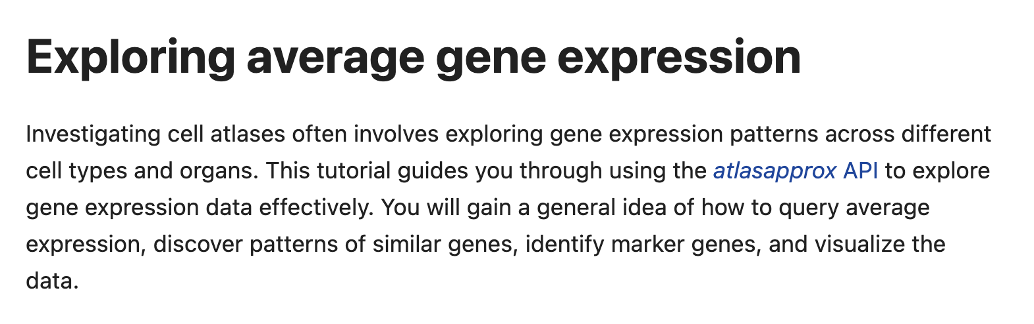
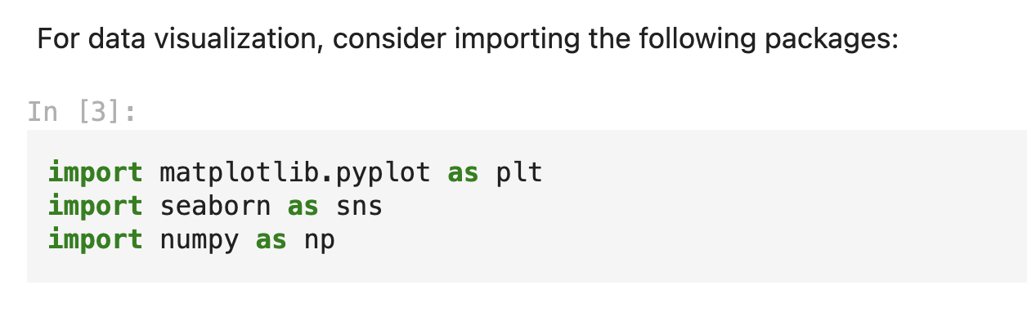
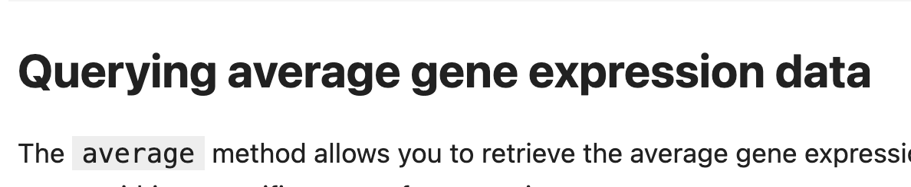
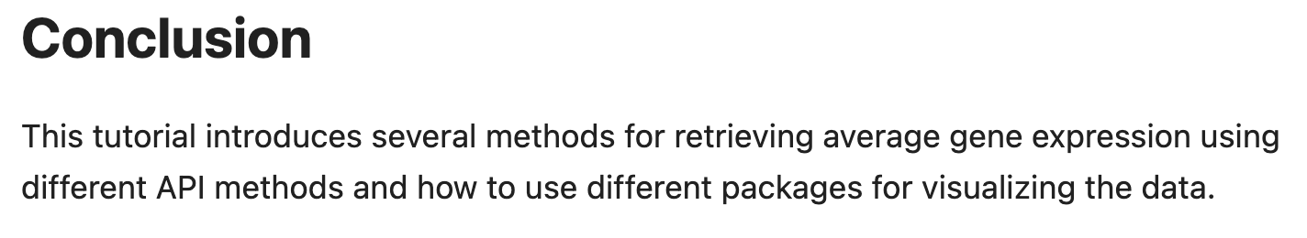
Demo
Clear
Expression
A meaningful introduction
Explain each import
Short and clear subtitles
A simple conclusion

Slide 13
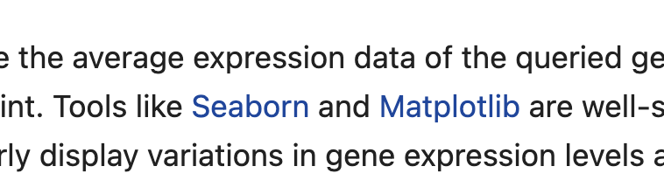
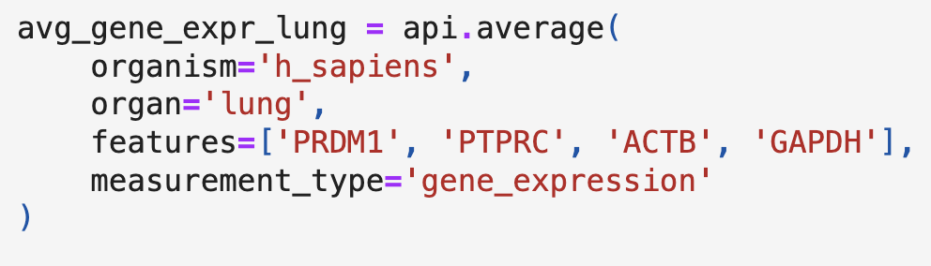
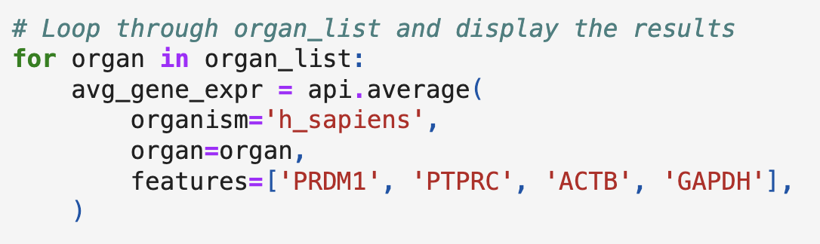
Demo
Direct approach
Use hyperlinks when necessary.
Choose reasonable and non-misleading examples.
Use simple code and logic.

Slide 14
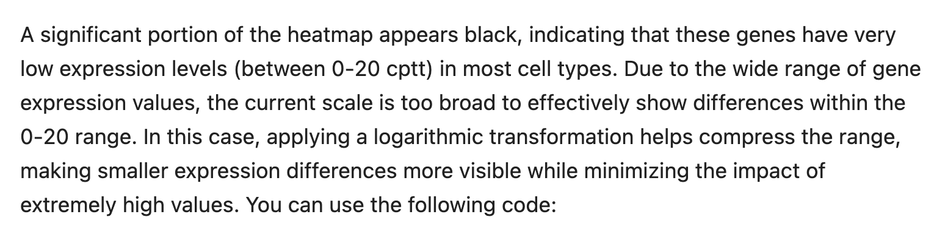
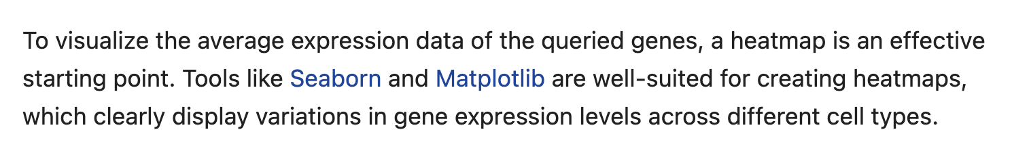
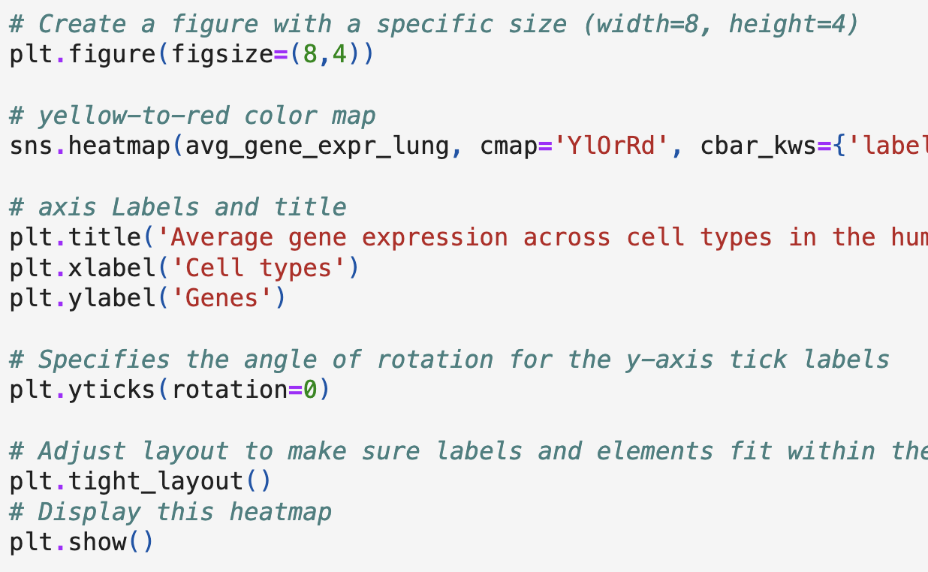
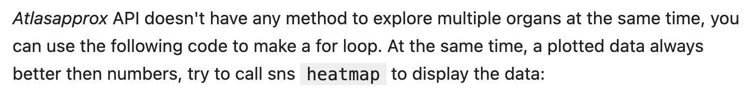
Demo
Essential explanation
Why apply this transformation?
Why display a heatmap?
Why write this line of code?
Why use a loop?

Slide 15
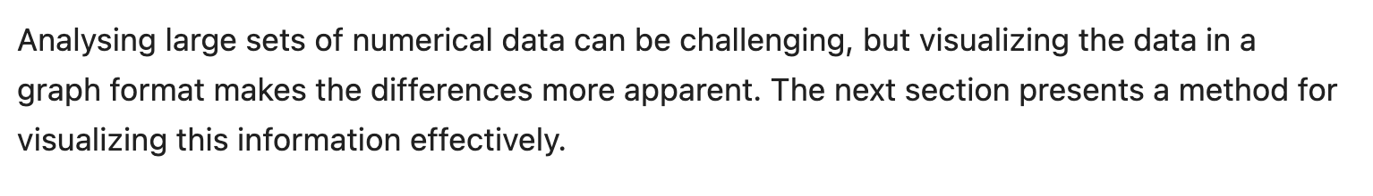
Demo
Overall Coherence
Title -> introduction -> code -> results -> linkage to the next example
Necessary transition words.
The logic inside each example.
Examples in a certain order and relevance.
Overall tutorial pattern.
Get data -> visualize data -> analyzing multiple data
Clear target with a defined research direction
-> Clear target, want to explore more related information.

Slide 16
Outlook

Slide 17
Coming soon
One tutorial per week
Highest measurement by cell types
Marker genes
gene coexpression
Gene homologs
neighbourhoods
week 1
Week 2
Week 3
Week 4
Week 5

Slide 18
THANK YOU

